Slide 1


Scopus Advanced Search
IE Business School
Martes, 11 de noviembre, 2025
Presentado por Pablo Secades, CSM Elsevier

Slide 2
Scopus advanced search allows you to enter complex search queries using field codes, boolean and proximity operators to narrow the scope of your search.
A query is a structured way to access information from and information system so it can be modified. In the context of database, queries are precisely formulated requests.

Slide 3
What Scopus search does automatically
Accented characters: work with or without the accent included
Example Dvořák and dvorak both return the same results
Lemmatization (similar but not quite the same as truncation or stemming) means that singular and plural forms, as well as adjectives, will be found if you type any of the variants.
Examples: attack and attacks; wide and wider
You can override this behavior by using the EXACT PHRASE marker
Equivalents: will find the equivalent terms/symbols
Example: ω and omega; behaviour (British spelling) and behavior (American spelling)
Punctuation: Commas, hyphens,?, ! etc., are ignored
Stop words: words like “the,” “it,” and “of” are excluded from search. Check complete list here.
Notes:
SSO

Slide 4
Wildcards as characters
“”
Used to connect adjacent terms
Used to find exact phrases
Replace a single character anywhere in a word
AFFIL (nure?berg) finds Nuremberg, Nurenberg …
Replace multiple characters anywhere in a word
criminal* = criminally , criminal
“criminal* insan*” = criminally OR criminal + insane OR insanity.
{}
?
*

Slide 5
Boolean operators
And / Or / And Not
Order of precedence rules
Searches with multiple operators are processed in the following order:
OR
AND
AND NOT
All these searches...
KEY (mouse OR rat AND rodent)
KEY (rodent AND rat OR mouse)
KEY (rat OR mouse AND rodent)
KEY(mouse OR rat) AND rodent
Notes:
SSO

Slide 6
Proximity operators
W/n
pain W/15 morphine
finds articles in which "pain" and "morphine" are no more than 15 terms apart
PRE/n
behavioural PRE/3 disturbances
finds articles in which "behavioral" precedes "disturbances" by three or fewer words.
General Operators preference
OR
W/n , PRE/n
AND
AND NOT
n = 0 to 255
n =15 = same sentence
n = 50 = same paragraph
Notes:
SSO

Slide 7
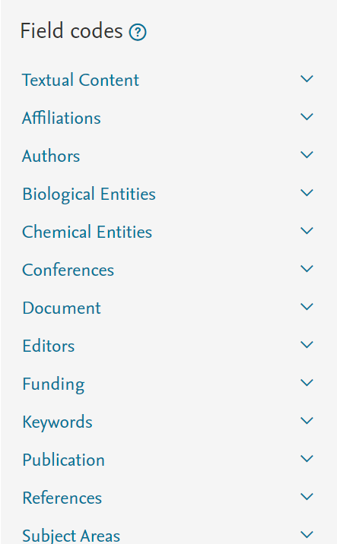
Field codes
You can search for a term in a specific field by entering the field code in your advanced search.
The search TITLE-ABS-KEY(prion disease) would return documents where the terms appear in the title, abstract or keywords.
PUBLISHER(Elsevier) will return documents from Elsevier.
Notes:
SSO

